Slide 1
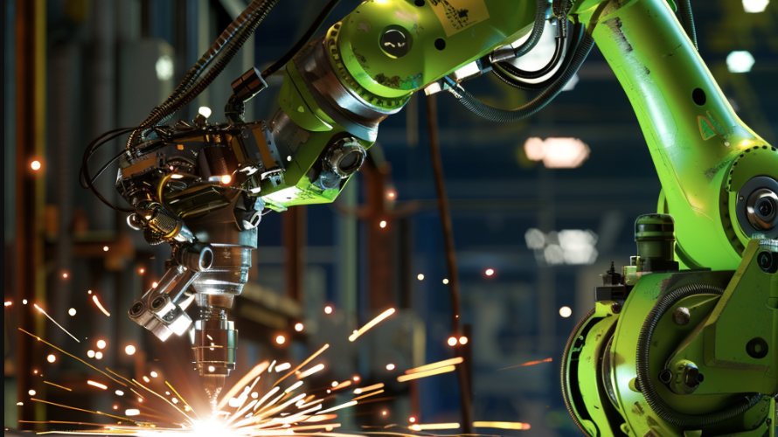

Welding Defect Detection with YOLO
25th of January 2025
Intelligent Systems
Fadi Aldeeb – 112537
Supervisor: prof. Joao Sousa

Slide 2
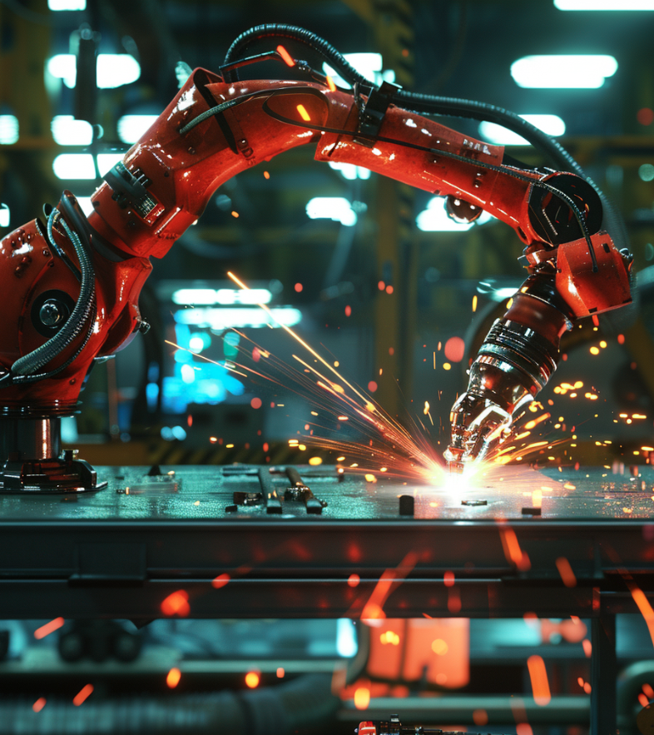
Contents
Scope of the Project
You Only Look Once (YOLO)
Dataset Analysis
Community Contributors
Models Used
Comparison of Trained Models
Best Model Evaluation
Comparison with other Contributors
Conclusions
Future Goals

Slide 3
Scope of the Project
Developing a YOLO-based object detection model
Understanding YOLO’s strengths and weaknesses
Highlighting the potential for integrating AI with mechanical engineering

Slide 4

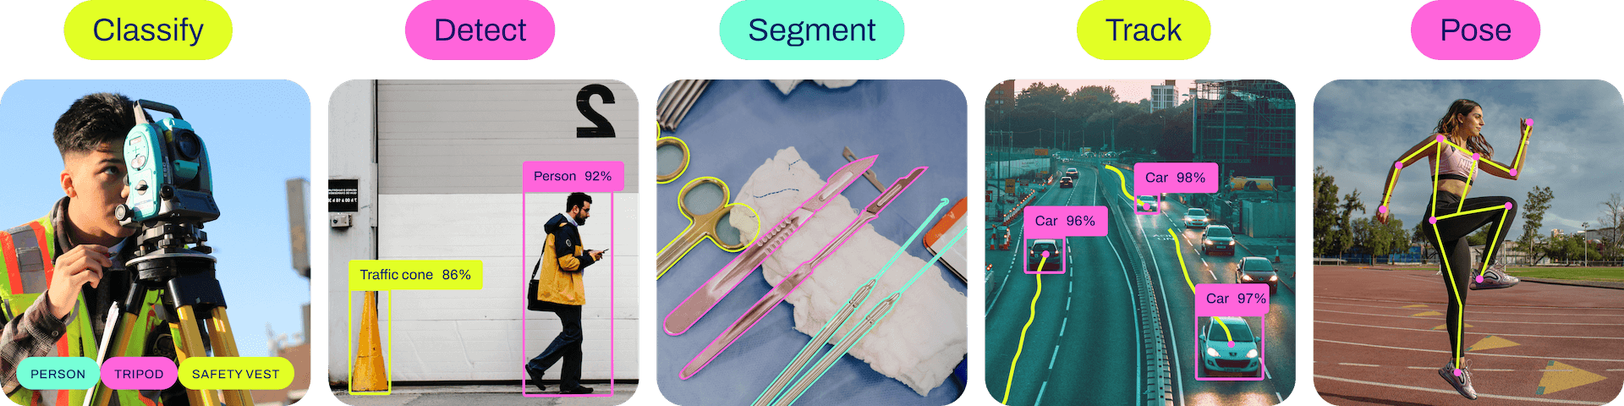
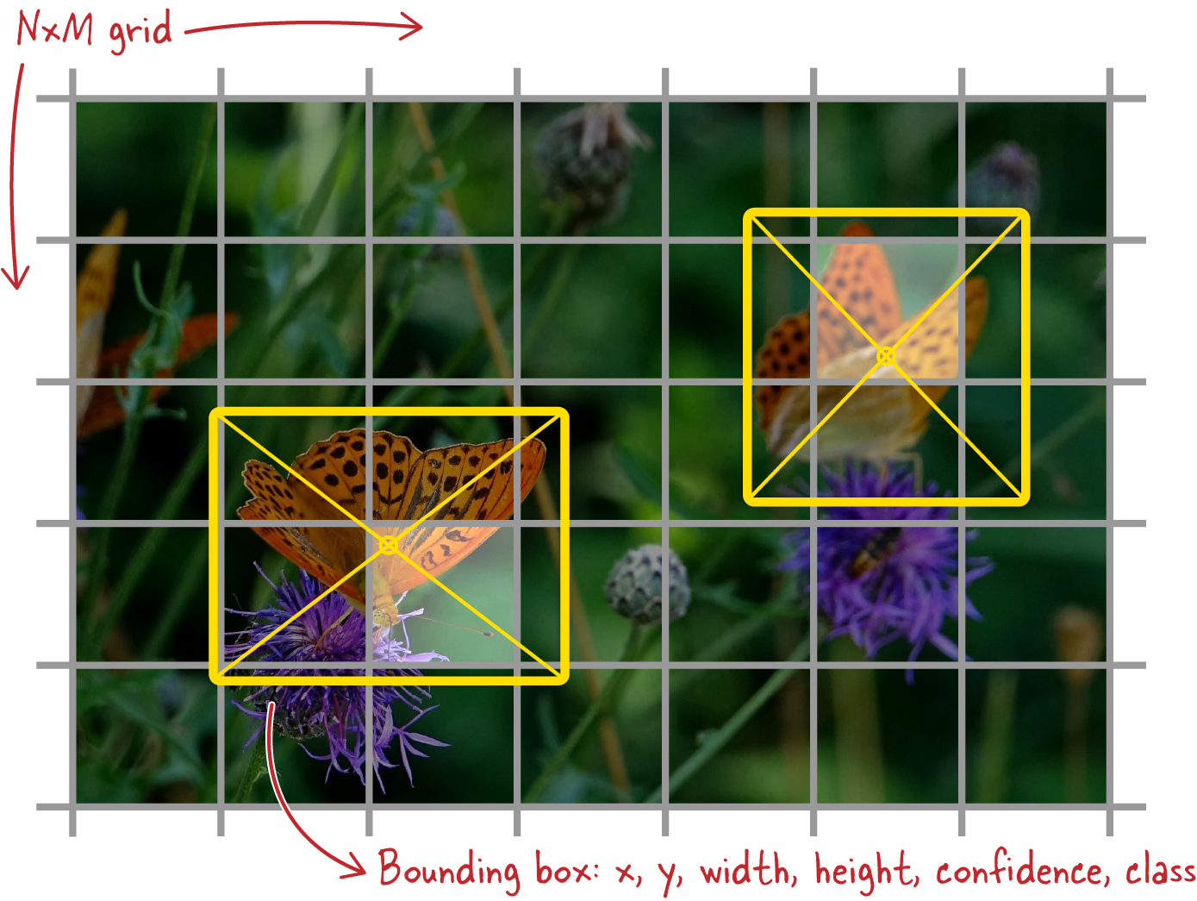
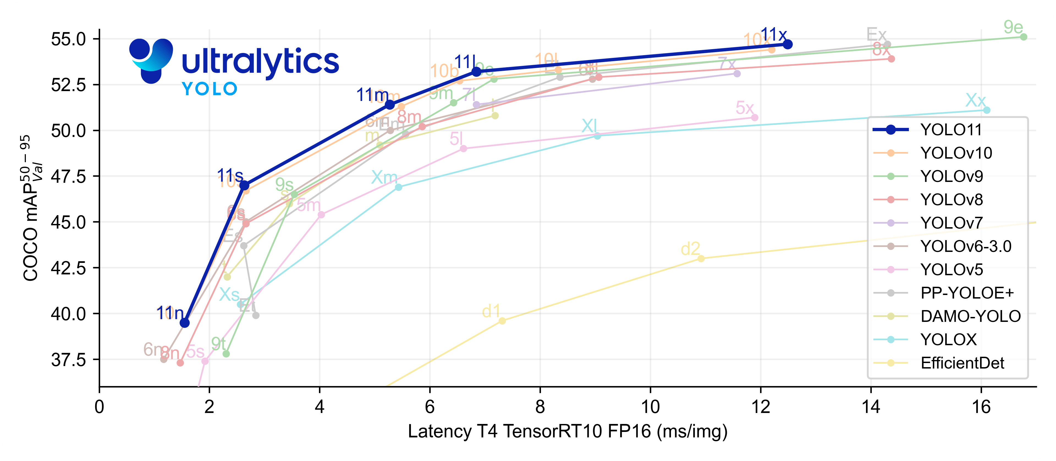

Slide 5

The Dataset Kaggle
Welding Defect Dataset
Small Dataset: 2028 welding images
Uniform size of 640x640 pixels
3 Classes: Bad Weld (0), Good Weld (1), Defect (2)
Number of Images in each Class
Percentage of Each Subset

Slide 6
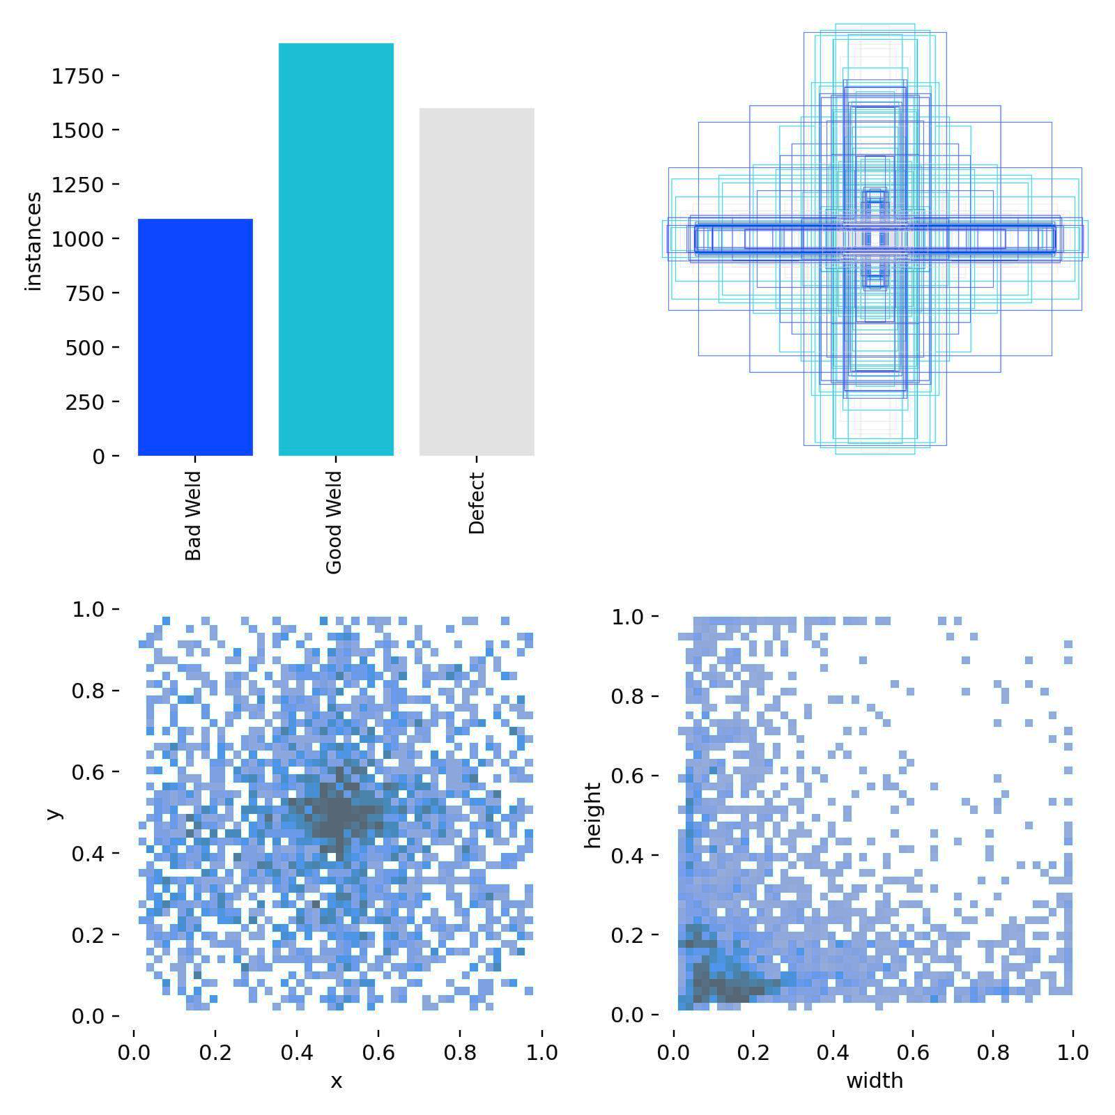
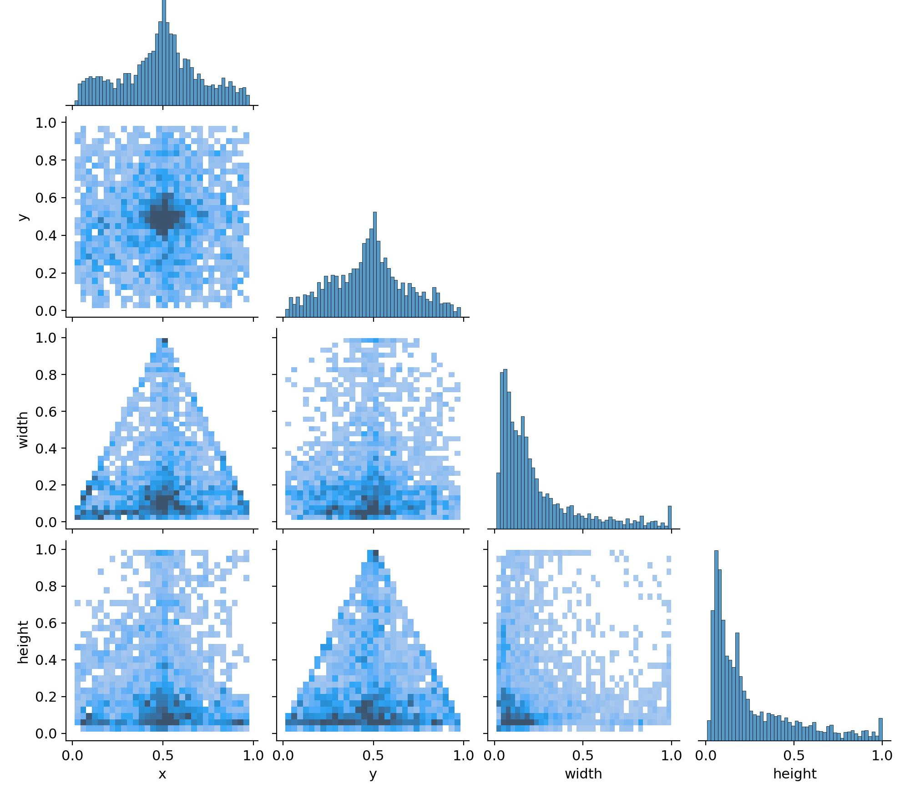
The Dataset Bounding Boxes Distribution
Location and sizes of Boxes
(Common Regions)
Labels Correlogram

Slide 7
Community Contributors
# | Publisher | Date Published | Model Used | precision | recall | f1 | mAP50 | mAP50-95
1 | Mohammed Mohsen | Dec 18, 2024 | yolov8m | 0.65 | 0.69 | 0.66 | 0.67 | 0.41
2 | Sinem Çelik | Oct 04, 2024 | Yolov9t | - | - | - | - | -
3 | Mike DeLong | Sep 01, 2024 | resnext50 | 0.93 | 0.91 | 0.92 | - | -
4 | Quan Hoang Ngoc | Aug 30, 2024 | yolov8n | 0.57 | 0.51 | 0.53 | 0.55 | 0.35
5 | Kero Ashraf | Aug 14, 2024 | yolov9m | 0.56 | 0.68 | 0.61 | 0.64 | 0.38
6 | Yossef Mohammed | Aug 11, 2024 | yolov9m | 0.56 | 0.68 | 0.61 | 0.64 | 0.38
7 | Muhammad Ellbendl Satria | Aug 06, 2024 | yolov8m | 0.69 | 0.49 | 0.57 | 0.56 | 0.3
8 | Muhammad Faizan | Jul 14, 2024 | yolov8m | 0.78 | 0.71 | 0.74 | 0.76 | 0.52
9 | Sukma Adhi Wijaya | Jun 30, 2024 | yolov8m | 0.79 | 0.70 | 0.74 | 0.77 | 0.54

Slide 8
Models Used
Highest Metrics Achieved By Wijaya:
1. YOLO Version 8 Nano Size
2. YOLO Version 8 Medium Size
Latest Model:
3. YOLO Version 11 Nano Size
4. YOLO Version 11 Medium Size

Slide 9
Comparison of Trained Models
Model | Running Time [h] | GPU Usage [MB] | Precision | Recall | F1 Score | mAP50 | mAP50-95
V8n | 2.932 | 3.89 | 0.75 | 0.70 | 0.72 | 0.75 | 0.50
V8m | 2.997 | 3.89 | 0.72 | 0.71 | 0.71 | 0.74 | 0.49
V11n | 2.561 | 1.29 | 0.75 | 0.64 | 0.69 | 0.71 | 0.45
V11m | 3.041 | 4.71 | 0.67 | 0.66 | 0.66 | 0.68 | 0.43

Slide 10
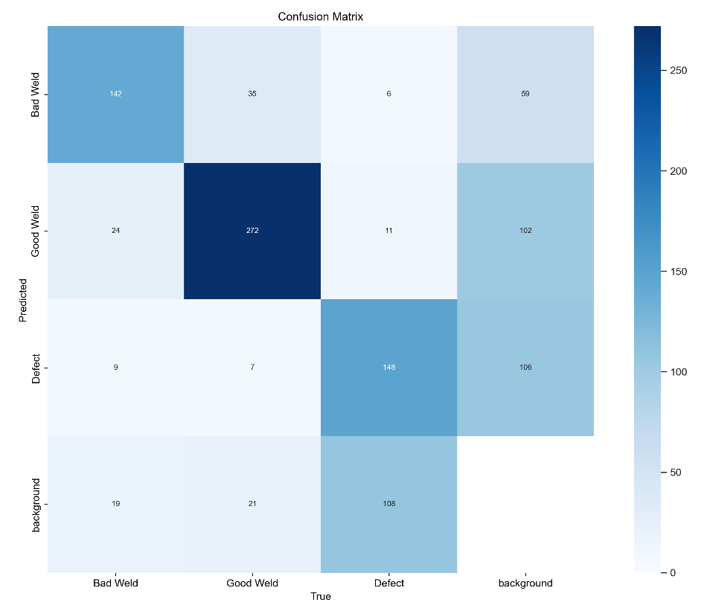
Best Model Evaluation YOLOv8 Nano
Class | Instances | Precision | Recall | mAP50 | mAP50-95
All | 802 | 0.75 | 0.70 | 0.75 | 0.50
Bad Weld | 194 | 0.72 | 0.78 | 0.81 | 0.59
Good Weld | 335 | 0.81 | 0.83 | 0.87 | 0.63
Defect | 273 | 0.72 | 0.50 | 0.56 | 0.56

Slide 11
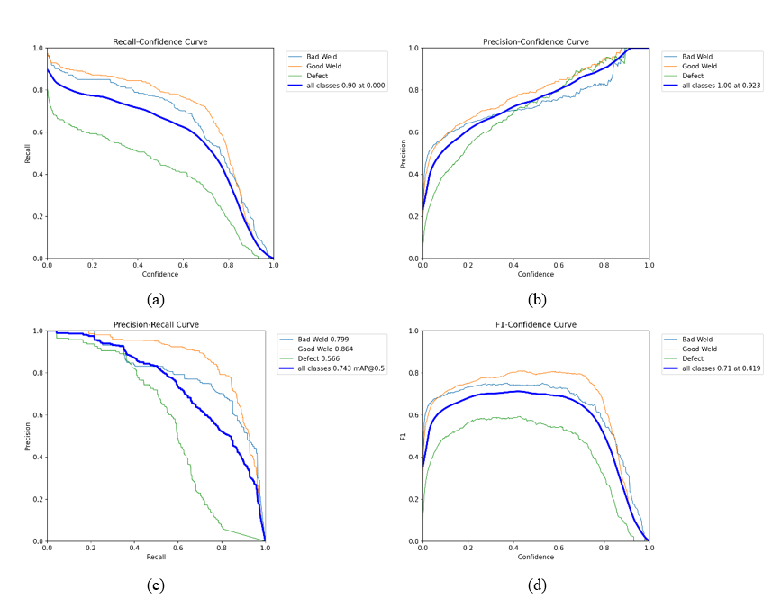
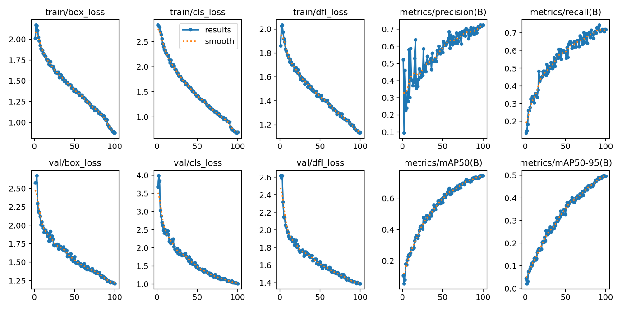
Best Model Evaluation YOLOv8 Nano
0.8816
1.1893

Slide 12
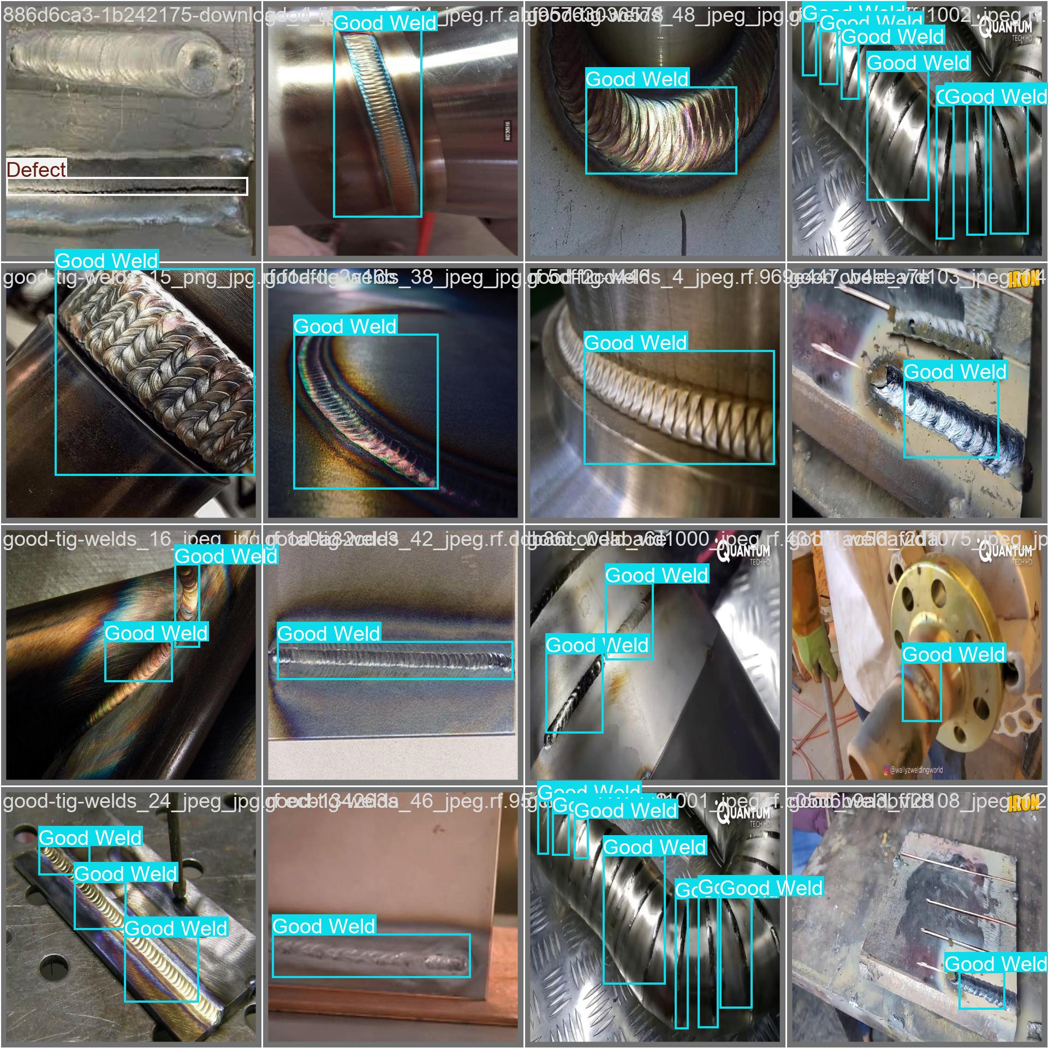
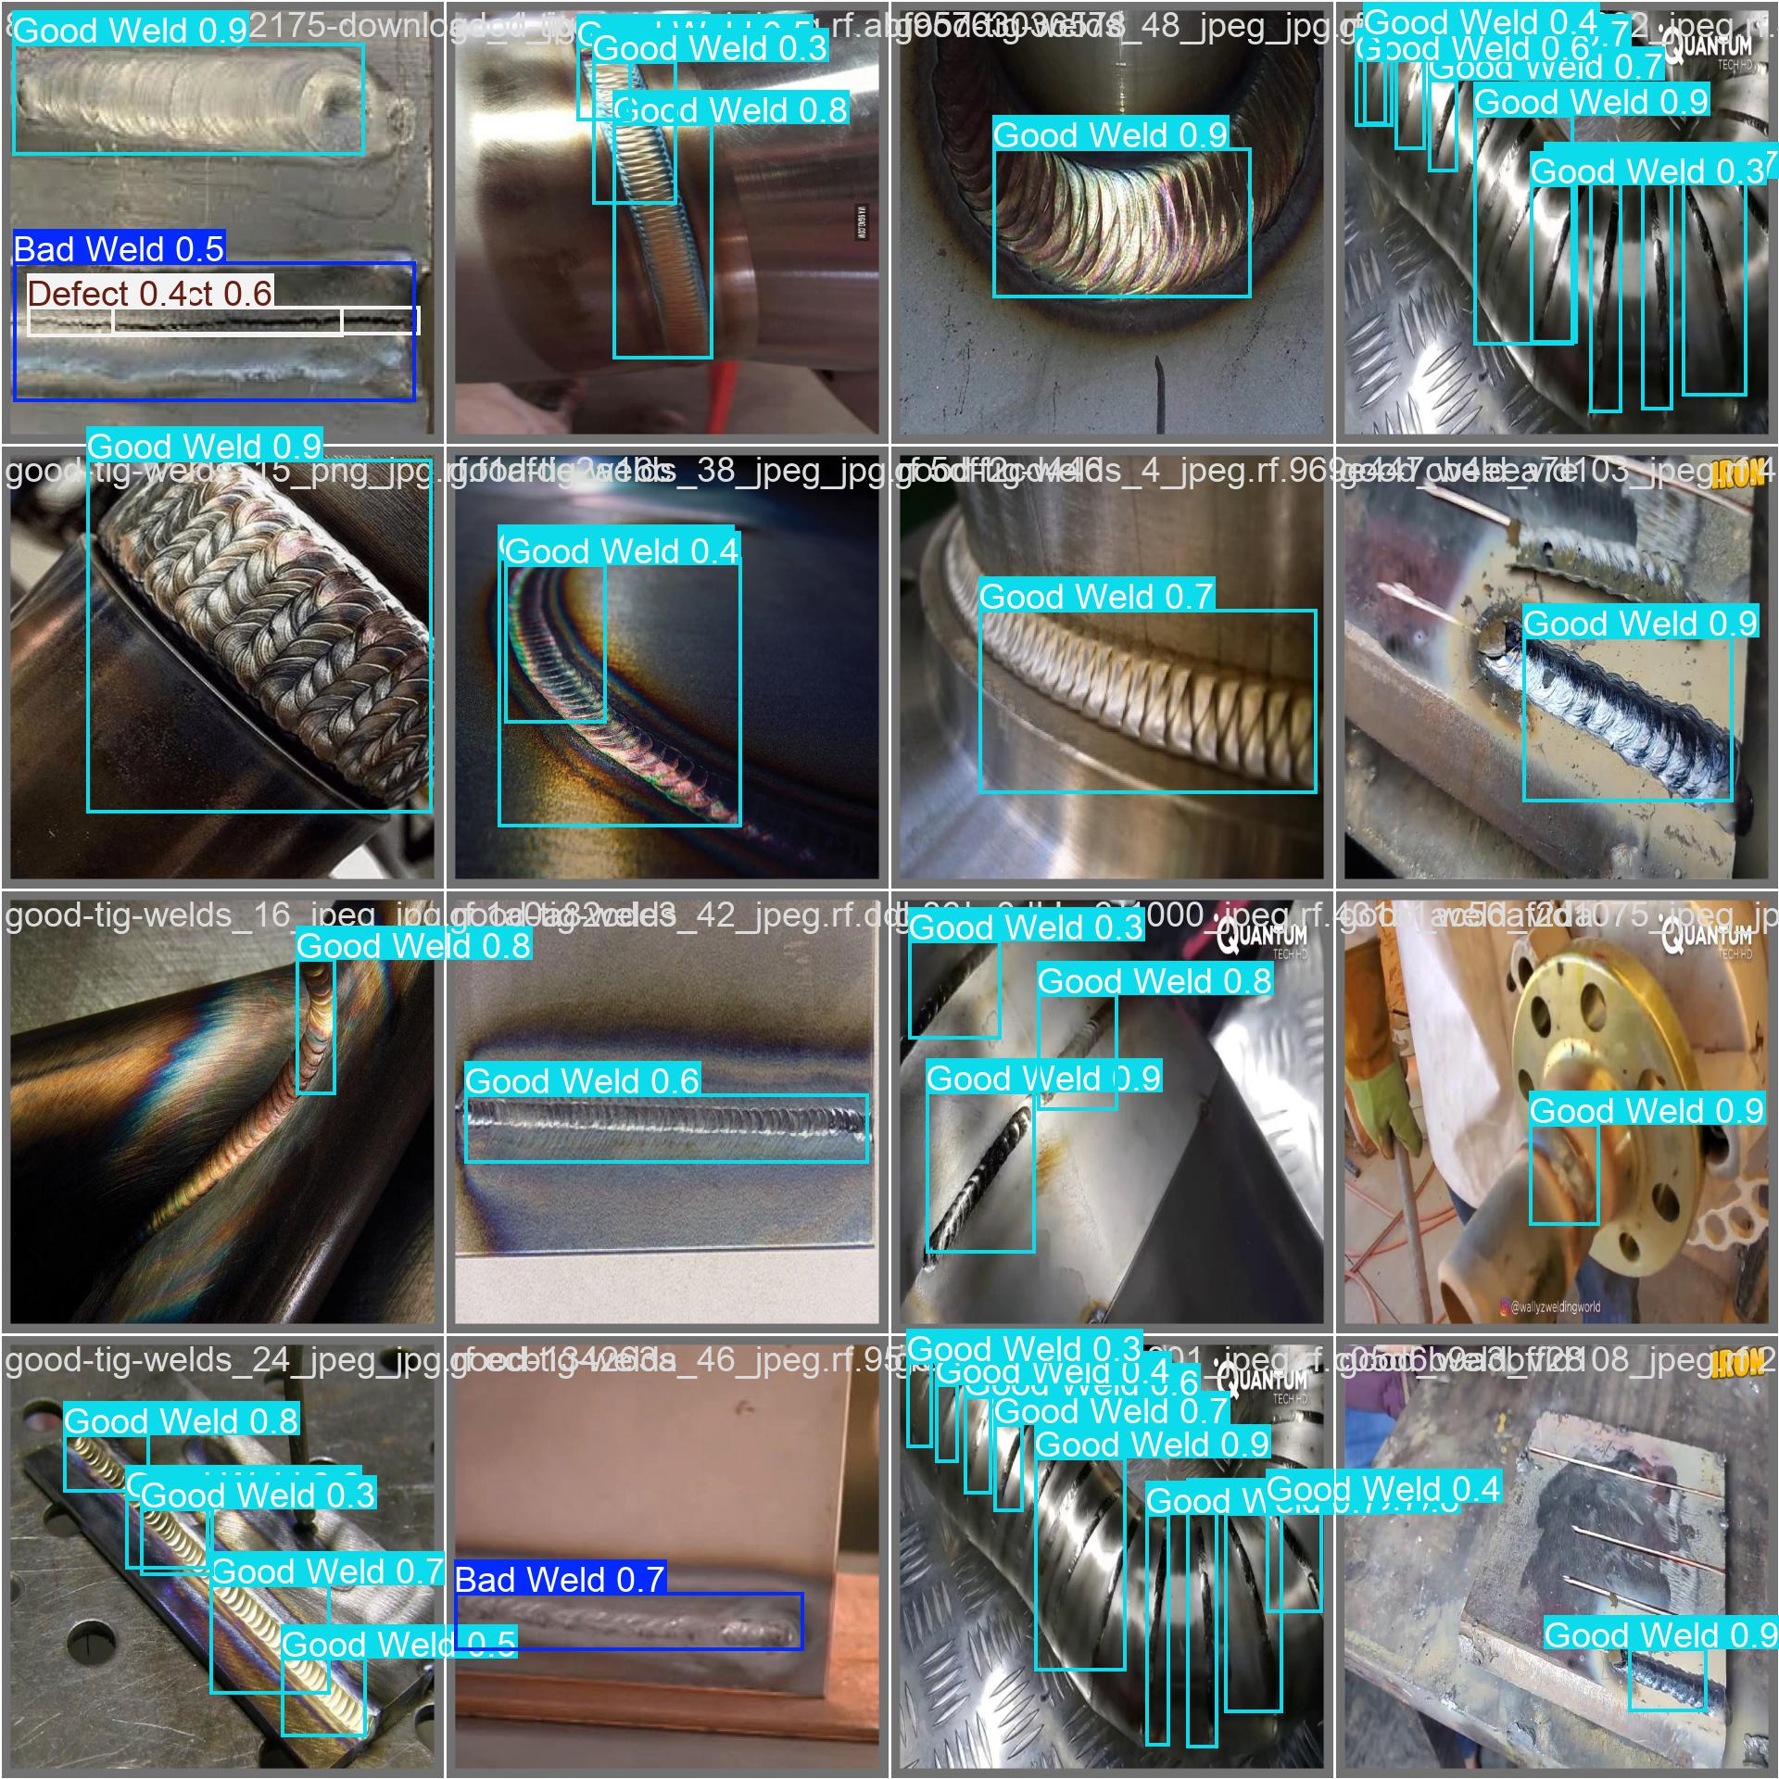
Best Model Evaluation YOLOv8 Nano
Labels
Predictions

Slide 13
Comparison with other Contributors
Model | Device Used | Usage | batch size | Epochs | Time [h] | Precision | Recall | F1 | mAP50 | mAP50-95
My V8n | Nvidia RTX 4060 | 3.89GB | 8 | 100 | 2.932 | 0.75 | 0.70 | 0.72 | 0.75 | 0.50
Wijaya V8m | Tesla T4 | 4.17GB | 16 | 120 | 1.150 | 0.79 | 0.70 | 0.74 | 0.77 | 0.54

Slide 14

Conclusions
Ultralytics YOLO are powerful:
Achieved a detection precision of 60-75% on small dataset.
High computational requirements:
Calculated GPU RAM requirements around 4GB, making it is not accessible to everyone.

Slide 15
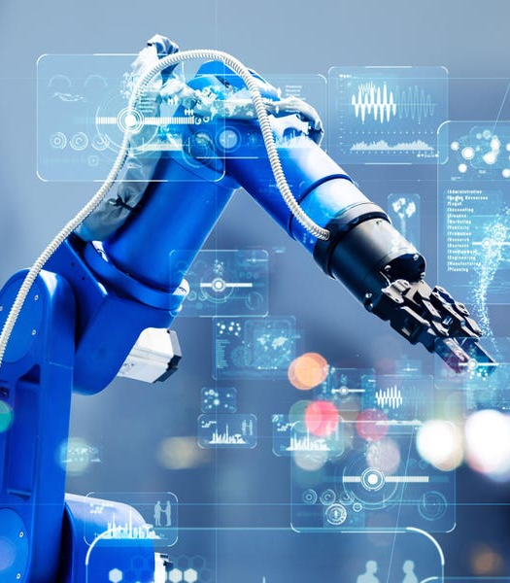
Future Goals
Secure a better device:
Train faster and longer
Better parameters search
Increasing the size of the dataset
Increasing Batch Size
Another direction:
Create complimentary software to calculate the actual dimensions of the defects and bad welding (image data needed).
Serving as the base of welding robotic arms input feed system.

Slide 16

Thank You For Listening

